Slide 1
CHAPTER 8: PRODUCT STRATEGY AND NEW-PRODUCT DEVELOPMENT
Copyright © McGraw-Hill Education. All rights reserved. No reproduction or distribution without the prior written consent of McGraw-Hill Education.
McGraw-Hill
Education
Part 3: Develop the Value Offering—The Product Experience

Slide 2
Learning Objectives
Understand the essential role of the product experience in marketing.
Define the characteristics of a product.
Recognize how product strategies evolve from one product to many products.
Understand the life of a product and how product strategies change over time.
Recognize the importance of new-product development to long-term success.
Understand the new product development process.
Identify how new products become diffused in a market.

Slide 3
Product: The Heart of Marketing
The product experience is at the core of delivering value to the customer.
The customer experience at Starbucks extends beyond coffee to social interaction and lifestyle.
If the product is wrong, great promotion, pricing, or distribution can’t save it.

Slide 4
What Is a Product?
A product is anything that delivers value to satisfy a need or want and includes physical merchandise, services, events, people, places, organizations, information, or ideas.
Product versus product item.
SKU: A stock-keeping unit.
Notes:
It is important to differentiate between a product and a product item. A product is a brand such as Post-it notes or Tide detergent. Within each product a company may develop a number of product items, each of which represents a unique size, feature, or price. Tide powder detergent offers 12 “scents,” including fragrance-free, in a variety of sizes designed to reach a variety of target markets. Each combination of scent and size represents a unique product item in the Tide product line and is known by a stock-keeping unit (SKU). An SKU is a unique identification number used to track a product through a distribution system, inventory management, and pricing.

Slide 5
Product Characteristics
Defining the Product
Essential benefit is the fundamental need met by the product (getting from point A to point B on an Southwest Airlines).
Core product is the physical, tangible elements (e.g., one kind of aircraft, low fares, good website).
Enhanced product includes additional features, designs, and innovation that exceed expectations (e.g., frequent flyer program, fun and entertaining flight attendants).

Slide 6
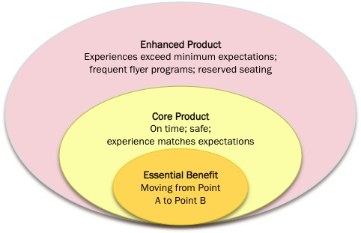
Defining the Product at Southwest Airlines
EXHIBIT 8.1
Link to long alt text description
©McGraw-Hill Education. All rights reserved. Authorized only for instructor use in the classroom. No reproduction or further distribution permitted without the prior written consent of McGraw-Hill Education.

Slide 7
Product Classifications
Four Ways to Classify Products
By nature of the products | Tangibility Durability
By who uses the products | Consumers Businesses

Slide 8
Product Classifications by Nature of the Product
Tangibility: physical aspects of the product experience
Durability: product usage
Notes:
Tangible products present opportunities (customers can see, touch, and experience the product) and also some challenges (customers may find the product does not match their personal tastes and preferences).
Durability references the length of product usage. Nondurable products are usually consumed in a few uses and, in general, cost less than durable products. Examples of consumer nondurables include personal grooming products such as toothpaste, soap, and shampoo, while business non- durables include office supplies such as printer ink, paper, and other less expensive, frequently purchased items. Because these products are purchased frequently and are not expensive, companies seek a wide distribution to make them as readily available as possible, create attractive price points to motivate purchase, and heavily advertise these products. Durable products have a longer product life and are often more expensive.

Slide 9
Consumer Goods
Convenience Goods | Staples, Impulse, Emergency
Shopping Goods | Furniture, Clothes, Appliances
Specialty Goods | Unique characteristics iPhone
Unsought Goods | Insurance
Notes:
Convenience goods: Frequently purchased, relatively low-cost products for which customers have little interest in seeking new information or considering other options and rely heavily on prior brand experience and purchase behavior. Includes subgroups of staples, impulse products, emergency goods.
Shopping goods: Products that require consumers to do more research and compare across product dimensions such as color, size, features, and price.
Specialty goods: a unique purchase made based on a defining characteristic for the consumer. The characteristic might be a real or perceived product feature such as Apple iPhone’s easy user interface or brand identification like Porsche’s reputation for building sports cars. Whatever the attribute(s), consumers apply decision rules that frequently minimize the number of different product choices and focus less on price. They are also more willing to seek out the product; however, expectations about product service, salesperson expertise, and customer service are higher.
Unsought goods: Products that consumers do not seek out and, indeed, often would rather not purchase at all. Insurance, for example.

Slide 10
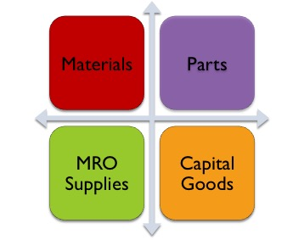
Product Classifications
Business Goods
Notes:
Businesses buy a vast array of products that can be classified into three broad areas based on two dimensions: (1) whether or not they are used in the manufacturing process and (2) cost. Goods incorporated into the company’s finished product as a result of the manufacturing process are either materials or parts. Materials are natural (lumber, minerals such as copper) or farm products (corn, soybeans) that become part of the final product. Parts consist of equipment either fully assembled or in smaller pieces that will be assembled into larger components and, again, used in the production process. In addition to the products that are used directly in the production process, companies purchase a number of products and services to support business operations. These can generally be placed on a continuum from low-cost/frequent purchases to very high-cost/infrequent purchases. MRO (maintenance, repair, operating) supplies are the everyday items that a company needs to keep running. At the other end of the cost/purchase-frequency continuum are capital goods, which are major purchases in support of a significant business function.

Slide 11
Product Discrimination: Create a Point of Differentiation
Form
Features
Performance Quality
Conformance Quality
Durability
Reliability
Repairability
Style
Notes:
Form The most elemental method of differentiating a product is to change its form—size, shape, color, and other physical elements. Many products considered very similar in functionality can be differentiated by variations in packaging or product delivery.
Features added or subtracted from a product to differentiate it from competitors. However, while delivering consumer value is the primary driver in making product decisions, a company must balance the features customers want with what they will pay at a given quality level.
Performance Quality Essentially, companies should build products to the performance quality level that their target audience is willing to pay for. Often this means a company will build products at multiple performance levels to meet demand at various price points. Keep in mind that the key is to deliver value to the customer.
Conformance Quality An important issue for consumers is conformance, which is the product’s ability to deliver on features and performance characteristics promised in marketing communications. The challenge for marketers and manufacturing is that every product must deliver on those promises. A product is said to have high conformance quality when a high percentage of the manufactured products fulfill the stated performance criteria. If someone opened a Coke and there was no “fizz,” it wouldn’t be a Coke.
Durability Consumer research and purchase patterns affirm that people find durability, the projected lifetime of the product under specific operating conditions, an important discriminating product characteristic and are willing to pay a premium for products that can demonstrate greater durability.
Reliability is the percentage of time the product works without failure or stop- page. Businesses and consumers consistently report this is an important discriminator in their purchase decision; however, a product can be too reliable. While it is possible to build computers that will last for years and cost a premium, most computer manufacturers do not build them because computer technology changes so quickly and product improvements happen so fast that people will not pay the premium for a computer that will last for many years.
Repairability Increasingly, consumers and businesses evaluate the repairability, ease of fixing a problem with the product, as part of the product evaluation process. As a result, companies have built better diagnostics into their products to help isolate, identify, and repair products without the need for the costly repairs of a professional service.
Style One of the most difficult discriminators to accurately assess and build into a product is the look and feel of the product, or style. It is easy for someone to say a particular product has style, but designing it into a product can be a challenge. More than any other discriminator, style offers the advantage of being difficult to copy.

Slide 12
Product Plan: Moving from One Product to Many Products
Product Line: A group of products linked through usage, customer profile, price points, and distribution channels or needs satisfaction
Product Mix: all the products offered by a company

Slide 13
Product Decisions Affect Other Marketing Mix Elements
Pricing
Individual product pricing within the product line
“good, better, best” product line strategy
Technology companies face special challenges as newer models have better features and lower prices
Marketing Communications
Focus on a single product or the brand?
Allocation of budget: Most popular products? Entire line? New products?
Notes:
Individual product pricing within the context of a broader product line requires a clear understanding of the price points for all the products in the line. Often multiple price points are targeted at specific markets with unique features following a “good, better, best” product line strategy.
A key strategic decision for marketers is the degree to which marketing communications focuses on a single product item versus a product brand. Usually, companies do both, but the emphasis on one approach versus the other makes a big difference in the communications strategy. A second communications issue is the allocation of communications budget
dollars across product items in a product line.
3M focuses much of its Post-it marketing communications on the Post-it product line, emphasizing the brand. Contrast that with Häagen-Dazs, which focuses on specific products (ice cream, sorbet, and yogurt) and specific product items within each product (chocolate, almond hazelnut swirl, pineapple coconut).

Slide 14
Building the Product Experience
Product Life Cycle
Sales revenue and profitability
Timeline
Caveats
Notes:
Notice there are two lines on the PLC graph. The top line charts the industry sales revenue for the product over time. The sales revenue line increases dramatically in introduction and growth stages as the product moves through the consumer adoption process. At some point, sales begin to decline. However, a sales decline does not necessarily mean the death of the product. Companies may create new products or market conditions may change, which can reinvigorate the product and start a new growth phase.
The speed at which products within a category move through the PLC is not consistent, and there is a great deal of variability across product categories. In some cases, a product moves through an entire cycle in a period of months and is replaced with the next product design. Fads come and go quickly, often reaching only a limited number of individuals but creating a lot of buzz in the marketplace. Often, women’s fashion is seasonal with a product line being introduced in the spring, moving through its growth cycle in the summer and fall, then finally into decline by winter. The cycle takes one selling season, in this case, one year. With other products such as men’s suits, it may take decades from introduction to decline. Men’s classic two-piece suits experience incremental changes every season, but the same basic design has been around for many years.
Caveats: The PLC is a helpful conceptual tool that works best when viewed as a framework for studying a product category. It can be difficult to know with certainty what stage a product is in, particularly at transition points in the PLC. Rather, the PLC enables marketing managers to assess historical trends in the category and track how the product has behaved over time.

Slide 15
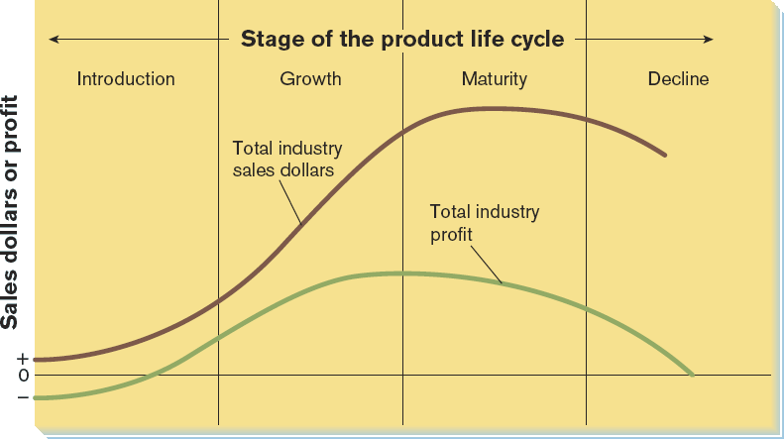
The Product Life Cycle
EXHIBIT 8.6
Link to long alt text description
Reprinted from Roger Kerin, Steven Hartley and William Rudelius, Marketing, 9th edition, 2009.
©McGraw-Hill Education. All rights reserved. Authorized only for instructor use in the classroom. No reproduction or further distribution permitted without the prior written consent of McGraw-Hill Education.
Notes:
The PLC is a useful tool because it provides a strategic framework for market analysis, (2) tracks historical trends, and (3) identifies future market conditions. The PLC generally refers to a product category (bicycles) rather than a product item (specific brand).

Slide 16
PLC
 | Intro | Growth | Maturity | Decline
Objective | Build awareness Trial purchase | Differentiate product from competitors Promote rapid expansion | Transition product from high growth to sales stability | Determine future of the product
Profitability | Low sales, typically high failure rate High marketing and product costs | Sales grow at increasing rate Profits are healthier as operations are streamlined | Sales increase at a decreasing rate Cost minimization has reached full extent | Long-run drop in sales Profit margins dramatically reduced

Slide 17
PLC: Market Conditions
 | Intro | Growth | Maturity | Decline
Market Segment | Nonexistent | New segment now established | Market approaching saturation | Changing tastes and substitute products erode share
Targeted Consumers | Innovators and Early Adopters | Early Adopters to Majority | Majority | Laggards
Competitive Environment | Little competition | Many competitors | Marginal competitors drop out | Falling demand forces many out of market
Competitor Reaction | Followers release similar products to pioneer | Large companies acquire small ones | Models emphasize style over function | Remaining firms focus on specialty products

Slide 18
PLC: Introduction Phase
Product: High-quality, innovative design providing new benefit to consumers. Features well-received and understood by target consumers.
Price: Price skimming or penetration.
Communications: Inform and educate target audience about the product’s features and benefits. Promotion focused on product awareness and to stimulate primary demand.
Distribution: Wide distribution network with limited product availability.
Notes:
Product: High-quality, innovative design providing new benefit to consumers. Features well- received and understood by target consumers.
Price: Price skimming or penetration
Communications: Inform and educate target audience about the product’s features and benefits. Promotion focused on product awareness and to stimulate primary demand.
Distribution: Wide distribution network with limited product Availability: Create anticipation by promoting excitement and sense of scarcity. Limit distribution but increase product availability: Release to limited number of target markets with high availability. Intensive personal selling to retailers and wholesalers.

Slide 19
PLC: Growth Phase
Product: More features and better design. Diversification of product and release of complementary products/services.
Price Penetration: New and improved models sold at high price points.
Price Skimming: Existing models or earlier generations move down in price.
Promotion: Link the brand with key product features and highlight differentiation between competitors. Promotion emphasizes brand advertising and comparative ads.
Distribution: Broaden distribution networks to keep up with expanding market demand.
Notes:
Product: More features and better design, learning from issues from first generation. Diversification of product and release of complementary products/services.
Price: New and improved models sold at high price points. Existing models or earlier generations move down in price.
Promotion: Link the brand with key product features and highlight differentiation between competitors. Promotion emphasizes brand advertising and comparative ads.
Distribution: Broaden distribution networks to keep up with expanding market demand.

Slide 20
PLC: Maturity Phase
Product: Product lines are widened or extended.
Price Penetration: Target high-end market, higher price.
Price skimming: Lower price due to competitive pressures if product is not well-differentiated.
Promotion: Decide between short-term sales promotion or investing more in the brand.
Distribution: Has reached maximum distribution.

Slide 21
PLC: Decline Phase
Product: Consider product expense in terms of ROI.
Price Penetration: Low price to stimulate demand.
Price skimming: Pressure from competitors and consumers.
Promotion: Cost not justified by conditions.
Distribution: Reduce channels.
Notes:
Product: Product lines are widened or extended. Work to further differentiate product from those of competitors.
Price: Target high-end market with differentiated product and higher price point.
Communications: Challenge of deciding between short-term sales promotions or investing more in the brand.
Distribution: Product has reached its maximum distribution. Channel members identify weak products and begin dropping out if necessary.

Slide 22
New Products Defined: Company Perpsective
Company Perspective:
New-to-the-world
Disruptive innovation are so innovative they create a fundamental change in the marketplace (e.g., connected clothing).
Sustaining innovations are newer, better faster versions of existing products or additions to existing product lines (e.g., Diet Coke, Coke Zero)
Reposition existing products
Add new market segments (e.g., cell phones from business usage to adults to teens).
Cost reduction
Introduce lower-cost products with fewer features or scaled-back warranty or service

Slide 23
New Products Defined: Customer’s Perspective
Customer’s Perspective
The customer’s perspective is much more narrow and self directed.
The customer is most interested in an answer to the fundamental question: Is this new product new to me?

Slide 24
Why Do Products Fail?
Company | Customers | Competitors | Environment
Inadequate value proposition. Poor marketing communications. Product does not meet customer expectations. Failure to fully develop product. | Change in purchase priorities. Higher expectations. | Aggressively attack new competition. | Changes in government regulation of legislation. Changes in societal demands. Economic changes.

Slide 25
New Product Development Process
The three major activities in new product development are:
Identify product opportunities.
Define the product opportunity.
Develop the product opportunity.

Slide 26
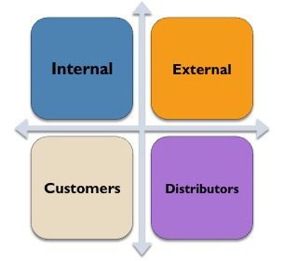
Identify Product Opportunities: Generate New Ideas
Generate new ideas.
Notes:
Internal Sources include employees from R&D, marketing, and manufacturing. Key employees know both the capabilities of the company and the needs of the market. Therefore, it is not surprising that internal sources are the single best source for new-product ideas. As salespeople, customer service representatives, and others interact directly with customers, it is possible to identify new-product ideas. Often these ideas are incremental changes to existing products that solve a particular problem; however, occasionally the customer challenge requires a truly innovative solution. Working with academia helps support the research activities of many organizations.
External An excellent source of ideas comes from individuals and organizations not directly connected with the company. In some industries, such as Internet applications, small entrepreneurs drive innovation. Google, Microsoft, and Apple all maintain dedicated staff whose job it is to identify and acquire new start-up organizations with great product ideas.
Customers Many companies encourage customer input directly online through e-mail and online discussion groups. Ford, BMW, Mercedes-Benz, and others sponsor user group bulletin boards that discuss improvements to existing products. While this will not likely lead to “new-to-the-world” products, it can lead to incremental or even substantial enhancements to existing products.
Distributors Distributors are a good source for new-product ideas particularly when they are the primary link between the customer and the company. Small organizations generally do not have the resources for a national sales force and use distributors in many markets.

Slide 27
Identify Product Opportunities: Evaluate Ideas
Screen and evaluate ideas.
Go-to-market mistake: Firm fails to keep a bad product idea from moving into product development
Stop-to-market mistake: A good idea is eliminated prematurely
Notes:
Go-to-Market Mistake Expensive mistakes often initiate a review of the screening process to figure out how the product made it through the development process. When the product fails to hit targeted benchmarks for success, the review may focus on errors in marketing strategy, target market adjustments, or competitive response to the product launch.
Stop-to-Market Mistake Most often companies are reluctant to talk about stop-to-market mistakes because it makes management uncomfortable and provides additional information about product development to competitors.

Slide 28
Identify Product Opportunities: Prioritize Ideas
Prioritize ideas that pass initial screening and evaluation.
Time to market (how long will it take to develop and get the product to market).
ROI (what is the expected return for the dollars invested in the project).
New product fit with overall company product portfolio.

Slide 29
Define the Product Opportunity
Define the product opportunity.
Define and test the product concept.
Create a marketing strategy.
Analyze the product’s business case.

Slide 30
Define and Test the Product Concept
Define and test the product concept.
Product definition objectives:
Define the value proposition.
Identify the target market and purchase frequency.
Delineate the product characteristics: Look, feel, physical characteristics, features
Notes:
Product definition has three objectives. First, it defines the product’s value proposition: what customer needs are being addressed and, in broad terms, at what price. Second, the definition briefly identifies the target market(s) and the purchase frequency. Third, the definition delineates the product’s characteristics (look, feel, physical elements, and features of the product). As the product moves through development, the physical characteristics become more defined and particular features, often at different price points, are included in the prototypes.45 Target customers are useful in defining the product concept. Companies present models, limited prototypes, and verbal or written descriptions of the product concept to customers, individually or in focus groups. Computer graphics are also used to depict elements of the product and even functionality. For example, in the development of new jet airliners, Boeing and Airbus develop sophisticated simulations that allow passengers to virtually sit in the airplane. In this way, customers get a more realistic perspective at a fraction of the cost to develop a full-scale working prototype.

Slide 31
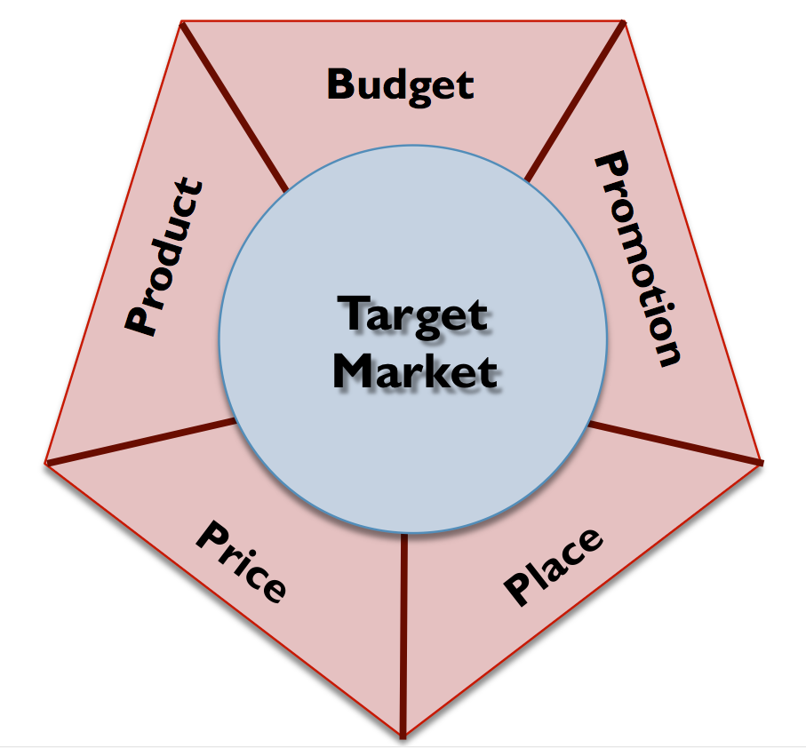
Create the Market Strategy
Create the Marketing Strategy
Notes:
First, defining the target market is helpful to the product developers. In addition to the basic market information (size, geography, and demographics), product developers appreciate knowing how the product will be used (context, environment) and psychographics of the market (the market’s activities, interests, and opinions). Marketers also assess the market share potential at critical points in time (how much market share can the new product get after one year). At this point, tentative pricing, distribution, and marketing communications strategies are created that will be adapted as the product gets closer to rollout. Often, as part of the initial marketing communications, appropriate publications will include articles about a new product. Finally, marketing managers begin to develop budgets for the product launch and estimates of the marketing communications budget, manufacturing capacity, and logistical needs.

Slide 32
Conduct Business Case Analysis
Conduct Business Case Analysis
Total Demand
New purchases
Repeat purchases
Replacement purchases
Profitability Analysis
Long- and short-term analysis
Notes:
New purchases—first-time sales. With new products, these sales are called trial purchases. This is also calculated as the trial rate (how many individuals in a particular target market have tried the product).
Repeat purchases—the number of products purchased by the same customer. This can be important with frequently purchased products such as convenience goods that rely on frequent repeat purchases for success.
Replacement purchases—the number of products purchased to replace existing products that have become obsolete or have malfunctioned. Estimates are made on the number of product failures in any given year based on the expected product life. As more products are sold into a market through first-time and repeat purchases, the number of replacement sales will increase.

Slide 33
Develop the Product
Develop the Product
Product testing: alpha and beta
Test the market
Consumer product market tests
Business product market tests
Product launch
Notes:
Alpha testing is done by internally by engineers, product specialists, and other employees.
Beta testing is done by potential customers.
Consumer Product Test Markets
Where: The location of the market test is based on how well it reflects the potential target markets. Most market tests involve somewhere between two and five cities to mitigate regional differences in purchases patterns (if there are any).
How long: Most test markets run less than a year. The test should be long enough to include several purchase cycles. With many consumer products, purchase cycles are relatively short (days or weeks) so there is less need for a long market test.
Data: Critical information needed to make necessary decisions must be identified. Management frequently wants to know how long it takes for the product to move through the distribution system, tracking the product from manufacturing plant through to the point of sale.
Decision criteria: Metrics for further action must be identified. At this stage it is difficult to pull a product, but if the product fails in the market test, management is faced with a difficult decision—drop the product or send it back for major redesign.
Business Product Market Test Products designed for business markets are tested differently than their consumer product counterparts. Essentially, the tests are smaller in scope and involve fewer individuals and companies; however, they are no less important in the new-product development process. Because business markets are smaller, beta testing often includes only a few key customers with a long-standing company relationship. If, on the other hand, the company has independent distributors, it identifies a limited number for the market test and provides additional support to them as the product is being tested.
Product launch
The product launch is critical to the long-term success of the product. Products that start poorly seldom recover from a poor launch. The pressure to create excitement, particularly for consumer products, leading to consumer trial purchase is a primary reason companies spend millions of dollars on a product launch. Many marketing communication dollars are front-loaded at the product launch with the goal of creating sufficient product interest that will turn into repeat and replacement purchases later.

Slide 34
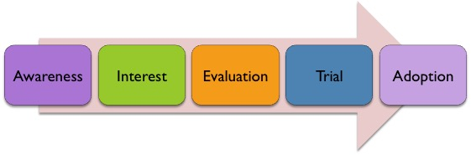
Consumer Adoption and Diffusion Process
Consumer Product Adoption Process
Innovation diffusion process is how long it takes a product to move from first purchase to last purchase (the last set of users to adopt the product).
An individual moves through five stages before adopting a product.
Notes:
Awareness—know of the product, but insufficient information to move forward through the adoption process.
Interest—receive additional information (advertising, word of mouth) and motivated to seek out added information for further evaluation.
Evaluation—combine all information (word of mouth, reviews, advertising) and evaluate the product for trial purchase.
Trial—purchase the product for the purpose of making a value decision.
Adoption—purchase the product with the intent of becoming a dependable user.

Slide 35
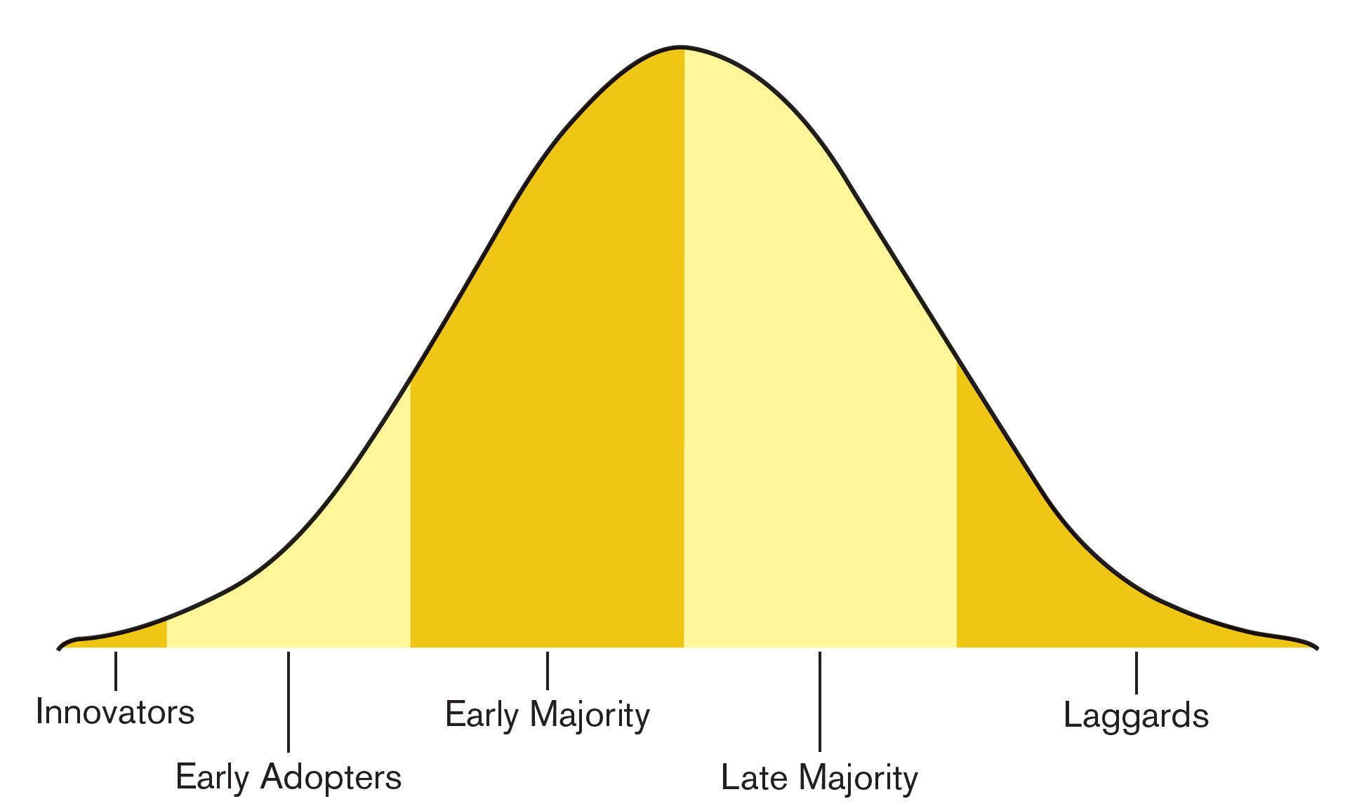
The Diffusion of Innovations
Link to long alt text description
Notes:
Innovators (2.5 percent)—Product enthusiasts enjoy being the first to try and master a new product. Individuals in this group are prime candidates for beta testing and represent a good source of feedback late in the product development process or early in the product launch phase.
Early Adopters (13 percent)—Product opinion leaders seek out new products consistent with the personal self-image. This group is not price-sensitive and is willing to pay the price premium for a product. At the same time, early adopters demand a high level of personalized service and product features.
Early Majority (34.5 percent)—Product watchers want to be convinced of the product’s claims and value proposition before making a commitment. This group is considered critical to long-term success as they take the product into the main stream.
Late Majority (34 percent)—Product followers are price-sensitive and risk-averse. They purchase older generation or discontinued models with lower prices and fewer product features.
Laggards (16 percent)—Product avoiders want to evade adoption as long as possible. Resistant to change, they will put off the purchase until there is no other option.

Slide 36
Alt Text Appendix
All long alt text descriptions are included in this appendix.

Slide 37
Defining the Product at Southwest Airlines
Three concentric circles illustrate how Southwest Airlines defines its product. At the center is the essential benefit, which is moving people from Point A to Point B. The center circle represents the core product, which is an experience that is on time, safe, and matches expectations. The outermost circle describes the enhanced product. This includes experiences that exceed minimum expectations, frequent flyer programs, and reserved seating.

Slide 38
The Product Life Cycle
A line chart shows sales dollars or profit on the y-axis. The x-axis represents the four stage of the product life cycle. They are introduction, growth, maturity, and decline. The top line graphs total industry sales dollars. The curve of this line is just above zero in the introduction stage, then steadily increases. It peaks at the maturity stage and begins to decrease in the decline stage, ending well above zero. The bottom line graphs the total industry profit. This line follows a similar path as the other line. It starts just below zero, then increases into the growth stage. Unlike the sales dollars line, the industry profit line peaks about two-thirds of the way through the growth stage, so its highest point is much lower. Total industry profit declines through the maturity and decline stages, ending at zero.

Slide 39
The Diffusion of Innovations
The diffusion of innovators can be represented by a bell curve. At the far right end of the curve are the innovators. As the curve increases, the next group is the early adopters. This is followed by the early majority, a category that ends at the peak of the curve. As the curve begins to decline, we find the late majority. Finally, the last group at the far left end are the laggards.

